Slide 1
MODULE 4
Electronic conversion systems application to renewable energy generation systems: Basic schemes and functional advantages
Power control and management systems for grid integration
Island detection systems
Synchronizing with the grid
Issues in integration of converter based sources
Network voltage management
Power quality management and Frequency management
Influence of PV/WECS on system transient response

Slide 2
Renewable Energy Conversion System

Slide 3
Wind power conversion
The function of a wind turbine is to convert the linear motion of the wind into rotational energy that can be used to drive a generator, as illustrated in Fig. 1.
Wind turbines capture the power from the wind by means of aerodynamically designed blades and convert it into rotating mechanical power.
At present, the most popular wind turbine is the Horizontal Axis Wind Turbine (HAWTs) where the number of blades is typically three.

Slide 4
Wind power conversion
Electric generators work on the principle of electromagnetic induction.
Electromagnetic Induction is a current produced because of voltage production (electromotive force) due to a changing magnetic field. This either happens when a conductor is placed in a moving magnetic field (when using an AC power source) or when a conductor is constantly moving in a stationary magnetic field.
How conversion happens in generator
The generation of electrical power requires relative motion between a magnetic field and a conductor. In a generator, mechanical energy is converted into electrical energy. The electricity produced by most generators is in the form of alternating current.
A power converter is an electrical circuit that changes the electric energy from one form into the desired form optimized for the specific load.

Slide 5
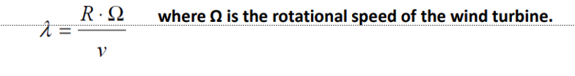
Wind Power
The aerodynamic power, P, of a wind turbine is given by:
where ρ is the air density,
R is the turbine radius,
v is the wind speed and Cp is the turbine power coefficient which represents the power conversion efficiency of a wind turbine.
Cp is a function of the tip-speed ratio (λ), as well as the blade pitch angle (β) in a pitch controlled wind turbine. The Betz limit, Cpmax (theoretical) =16/27, is the maximum theoretically possible rotor power coefficient.
λ is defined as the ratio of the tip speed of the turbine blades to wind speed, and given by:

Slide 6
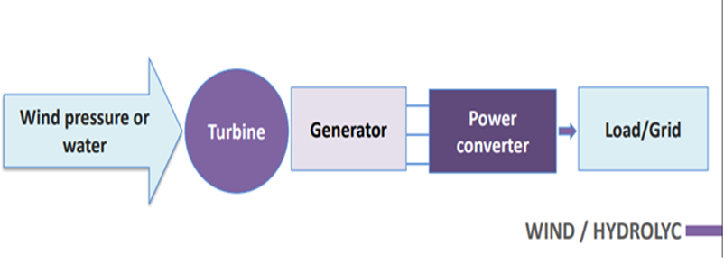
Basic schemes and functional advantages Wind energy
Wind energy is an alternative to fossil fuels,
it is plentiful
Renewable
widely distributed
Clean
low cost
produces no emissions during operation
uses a tiny land area
The effects on the environment are generally less problematic than those from other conventional power sources.

Slide 7
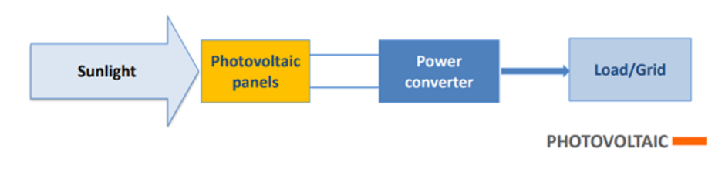
Basic schemes and functional advantages Solar Power
An energy source that is both renewable and inexhaustible
Solar Power Reduces Carbon Emissions
Solar Panels Reduce Dependence on the National Grid
Using solar energy helps drastically cut down the electricity you use from the national grid.
Solar Energy is Sustainable
Solar Panels are Long-Lasting
It can be used on under utilised land
Solar Power is Good for the Economy

